Slide 1
TRAVEL ENTREPRENEURSHIP AND SUSTAINABLE MARKETING Lecture 22
Topic:
Factors Influencing Tourism Entrepreneurship

Slide 2
Entrepreneurial activity is a dynamic process that encompasses all stages of the formation and development of a business:
From an innovative idea to its successful commercialization
From the idea of creating a new entrepreneurial business to the emergence of early entrepreneurs to a stable company operating in a complex competitive environment

Slide 3
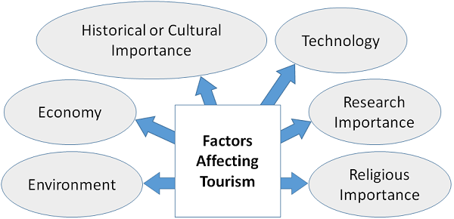

Slide 4
